Slide 1
Blockchain Research (Informal Sharing)
My Perspectives on Blockchain Research:
Current and The Future
Shan Jiang
Research Assistant Professor,
The Hong Kong Polytechnic University
Email: cs-shan.jiang@polyu.edu.hk
Homepage: https://www4.comp.polyu.edu.hk/~cssjiang/

Slide 2
What is Blockchain
Blockchain
A technology of distributed ledger for trustless data management with auditability
Blockchain 1.0
Cryptocurrencies
Bitcoin, Litecoin
Blockchain 2.0
Smart contract
Ethereum
Blockchain +
Enterprise-customized solutions
Hyperledger Fabric
Decentralization: removal of third party
Transparency: visible to everyone
Immutability: once stored, cannot be changed

Slide 3
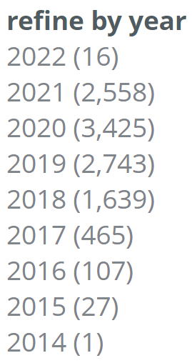
Diversity of Blockchain Research
Blockchain involves almost all computer science areas and even more
Parallel and distributed computing
Computer networking
Cybersecurity
Software engineering
Database systems and data mining
Artificial intelligence
Theoretical computer science
Pervasive computing
Economy
Finance & Regulation
#blockchain papers
(statistics from BDLP)

Slide 4
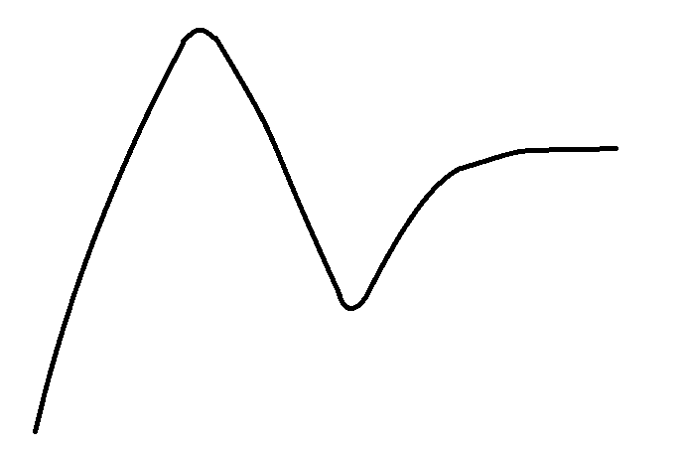
Blockchain Research Directions
Blockchain & edge computing
Blockchain & federated learning
Blockchain as a service
Blockchain data sharing
Blockchain & 6G
Cross chain protocols
Selfish mining
Decentralized finance
Zero-knowledge proof
Sharding
Blockchain economy
Smart contract analysis
Searchable blockchain
Micropayment Channel
Redactable blockchain
Only Personal Perspective!

Slide 5
Impactful Research
阳春白雪。
It’s really fundamental
Blockchain consensus (with rigorous proof)
Zero-knowledge proof protocols (not simple applications)
Sharding protocols
It’s really important or (better and) practical
Decentralized finance
Smart contract security
Blockchain as a service
下里巴人。

Slide 6
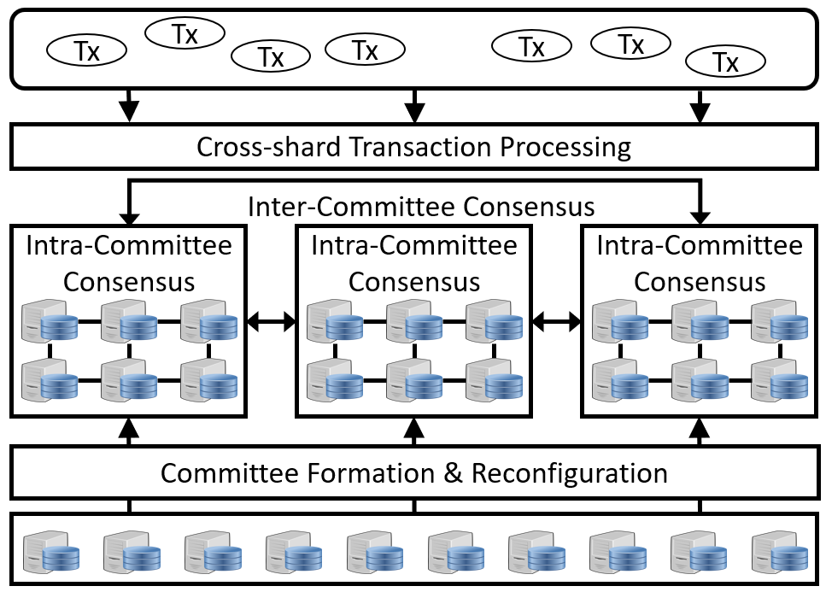
Example: Sharding Protocol
Key Idea: divide blockchain network into several slices (shards)
Intra-committee consensus
Inter-committee consensus
Representative works
Elastico (CCS’16)
OmniLedger (SP’18)
Rapidchain (CCS’18)
Chainspace (NDSS’18)
Monoxide (NSDI’19)

Slide 7



Example: Searchable Blockchain
Performance Metrics
Integrity – whether result is sound and complete
Privacy – data leakage during searching?
Efficiency – time, communication, financial overhead
Techniques
Verifiable computation
Searchable encryption
efficiency
high
low
searching request
low
high
integrity
low
result
high
…
User
Blockchain network
Blockchain
privacy
Expert: Prof. Jianliang Xu

Slide 8
Blockchain Future Research
Performance and security are two long-standing issues
Blockchain is emerging in finance, economy, and regulation
It’s promising to make blockchain the communication infrastructure
Blockchain needs killer applications beside cryptocurrencies
Only Personal Perspective!

Slide 9
Ad: Blockchain Research in PolyU IMCL
Main focus
Blockchain-empowered Collaborative Edge Computing
Blockchain-based Big Data Sharing
Some other topics
Integration of Blockchain and Federated Learning
Blockchain as a Service
Sharding Protocol
We are open to exciting ideas
Looking forward to cooperation & your joining
https://www4.comp.polyu.edu.hk/~labimcl/
https://www4.comp.polyu.edu.hk/~cssjiang/
cs-shan.jiang@polyu.edu.hk

Slide 10
Thank you so much!
Notes:
Thank you very much!

